Slide 1


Slide 2

Data Science. Week 7. Seminar

Slide 3
Week 7. Reminders
Reminder: Office hours.
RD: Tues, 14:00-15:00 (Room 2E1, Priory House, 8 Woodland Road)
JH: Thu, 10:00-11:00 (online)
DC: Thu, 11:00-12:00 (online)
FM: Friday, 13:30-14:30 (online)
Reminder: Portfolio tasks
These are set each week and make up 20% of your grade. They can be found in the course DropBox. The file is here

Slide 4
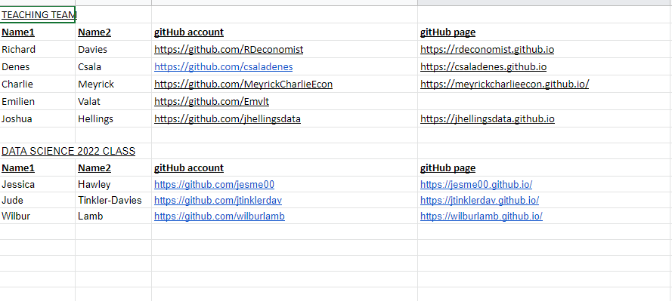
Week 7. Reminders
Reminder: Class Google Sheet
Please add your name, student ID, GitHub account details to the class spreadsheet. This is here

Slide 5

Data Science projects.

Slide 6
Assessment. {Deadline: 6th Dec 11am}
Coursework. The coursework consists of two parts.
DS Portfolio (20%). In each of the first 10 weeks you learn the steps to produce charts, tables or visualisations. These are worth 20% of your grade. Each week is graded equally, i.e. 2%. These should be completed during the week. Note that the portfolio is NOT the same as for 2022.
DS Project (80%).
Between 3 and 8 charts. Embedded in your site, hosted by GitHub pages.
An accompanying write-up (also embedded on your page) discussing:
the aims of your project;
the data you used, how you accessed it, including notes on automation/replication;
challenges in data cleaning and/or analysis, and the tools you used to overcome them;
your conclusions.
Each section must not exceed 200 words.

Slide 7
From the archive. Some of the best projects from previous cohorts
Projects from last year can be found here: https://rdeconomist.github.io/datascience2022

Slide 8
Marking criteria.
Accessibility.
Hosted on a GitHub page – open data approach
Clear link to data and notes in code
Mobile first: site should be clear on a smartphone screen
Design.
Clarity of question
Choice of data sets
Empirical approach
Automation.
Use of APIs
Replicability of project
Impact.
Key takeaways from the project
Interactivity of the data
Description.
Clarity of write up
Logical steps from data to conclusions
Does the project stimulate further work?

Slide 9

Data gathering - scraping. How to build your own tool if there is no API.

Slide 10
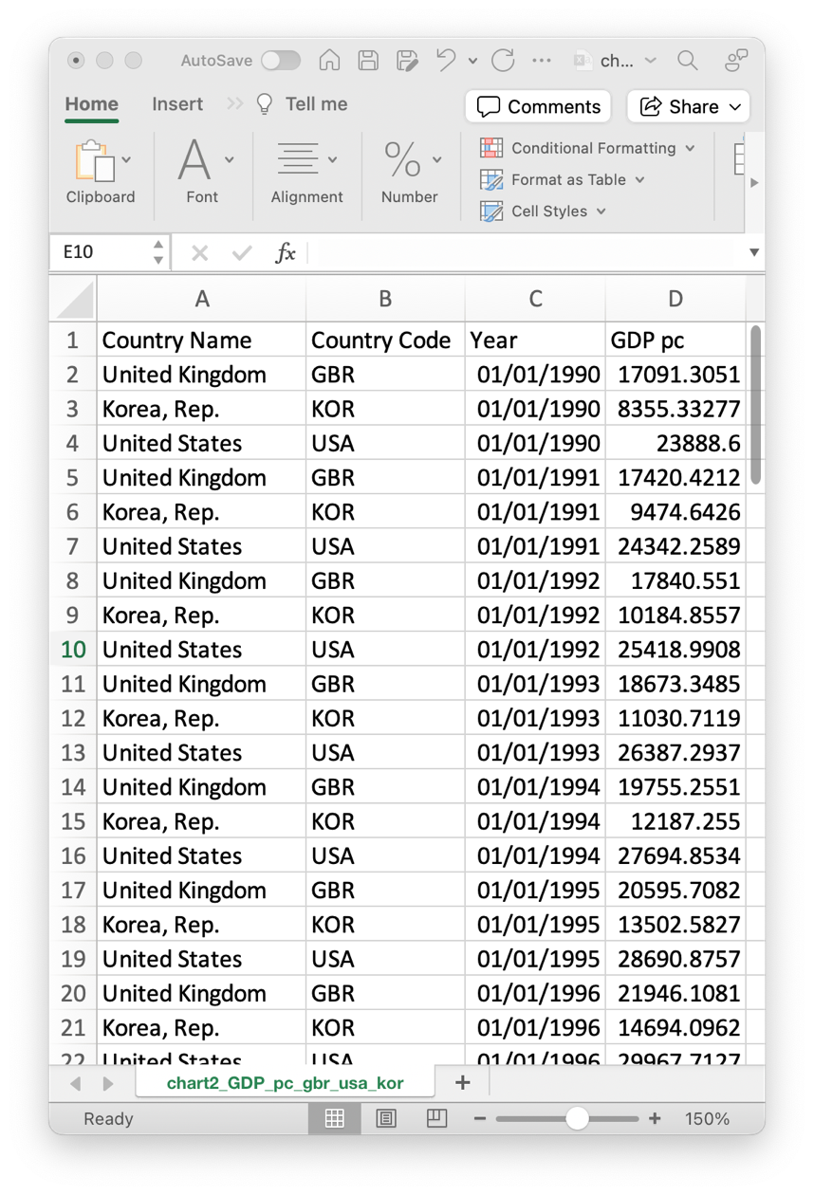
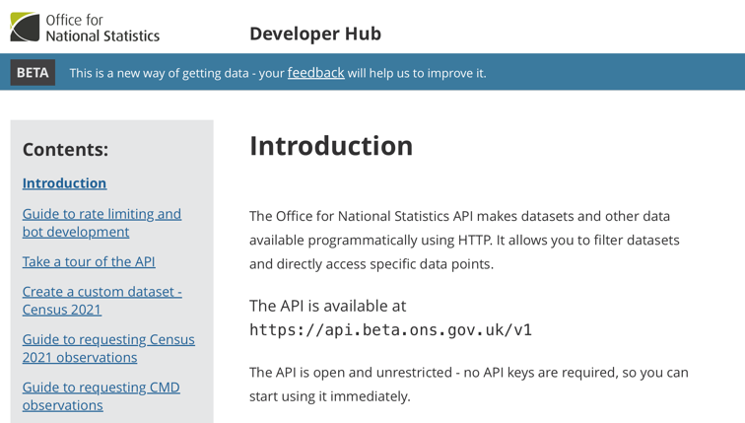
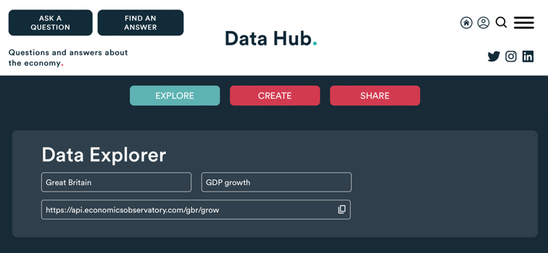
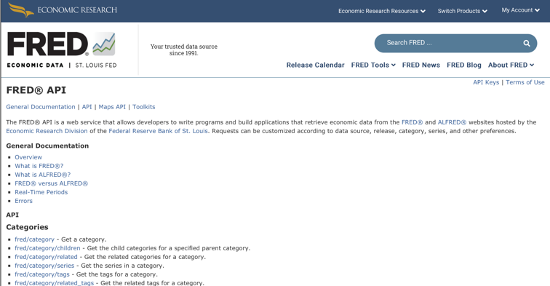
Data, so far…
Sources we’ve seen
Structured Files
(e.g. Excel, CSV, JSON)
APIs
(e.g. ONS, ECO, FRED)
But what do we do when the data we want isn’t available?
Notes:
Indonesia

Slide 11
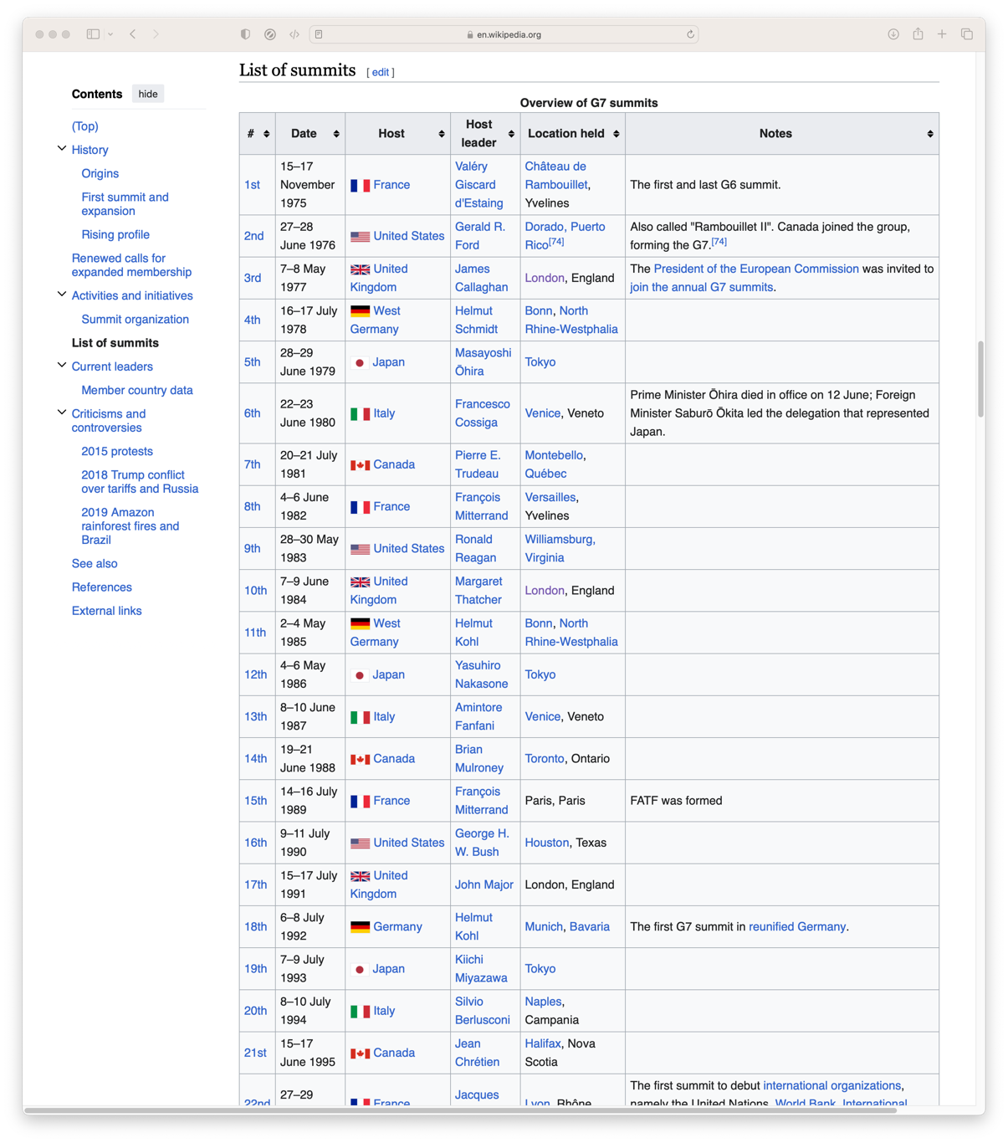
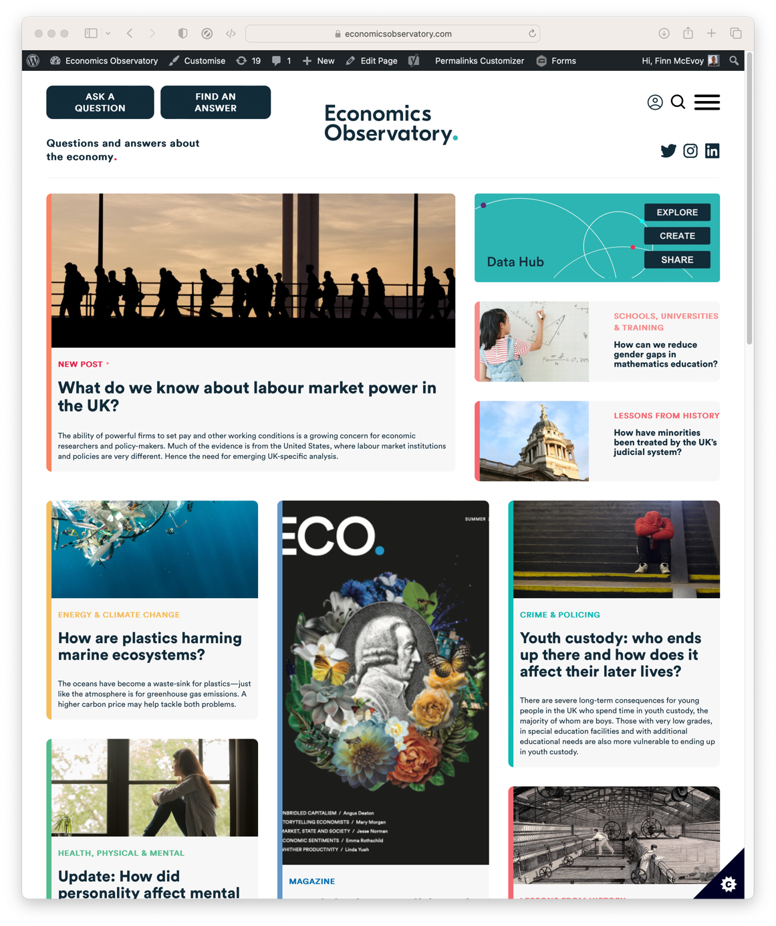
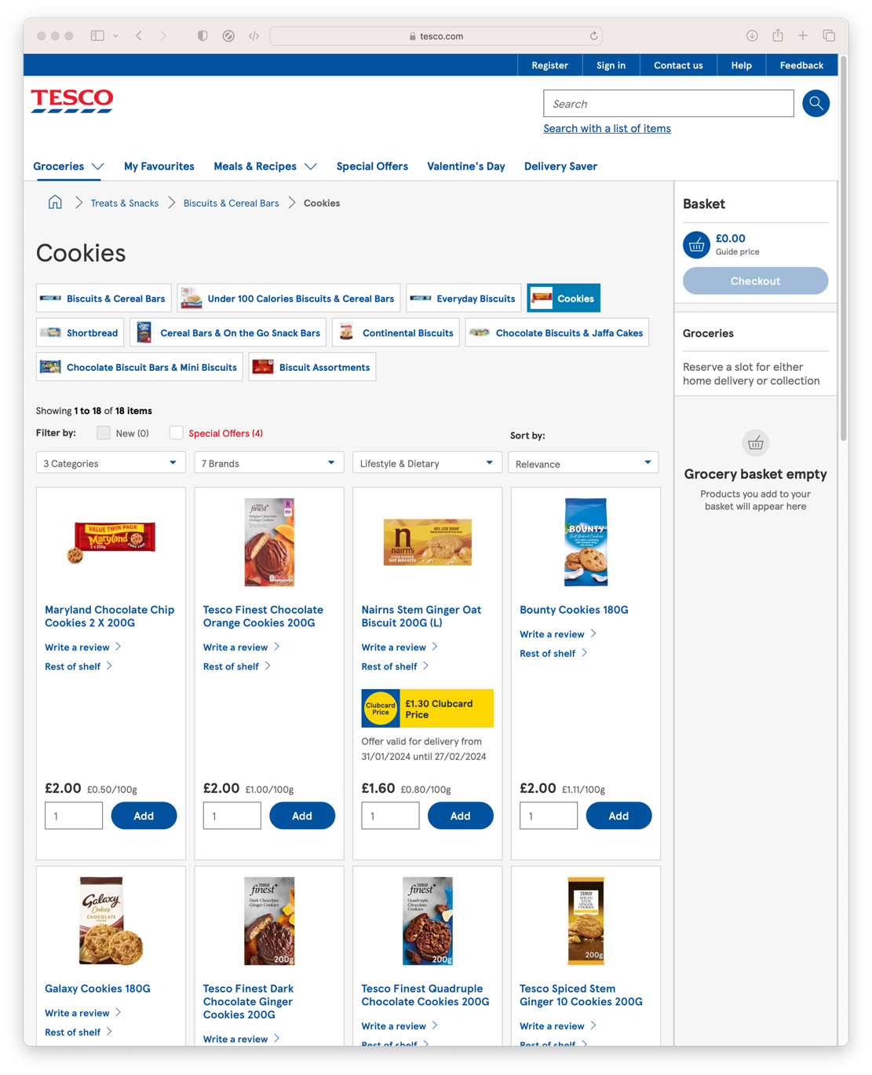
Data, so far…
What if we want
Data from Wikipedia
News and Media
Prices from Supermarkets

Slide 12
Scraping.
What if we want.
The automated extraction of data from websites
Scraping the HTML source. Easy. Automated.
Scraping static HTML pages.
A bit more difficult. Can be automated.
CAPTCHA. Impersonating a human user. Zombie browser.
Scraping HTML pages generated on-the-fly with JavaScript.
Hard. Only zombie browser works, and only in some cases.
Notes:
hiQ labs vs. LinkedIn, 2019, US Court of Appeals for the Ninth Circuit, 17-16783
LinkedIn vs. hiQ labs, 2021, US Supreme Court, 19-1116

Slide 13
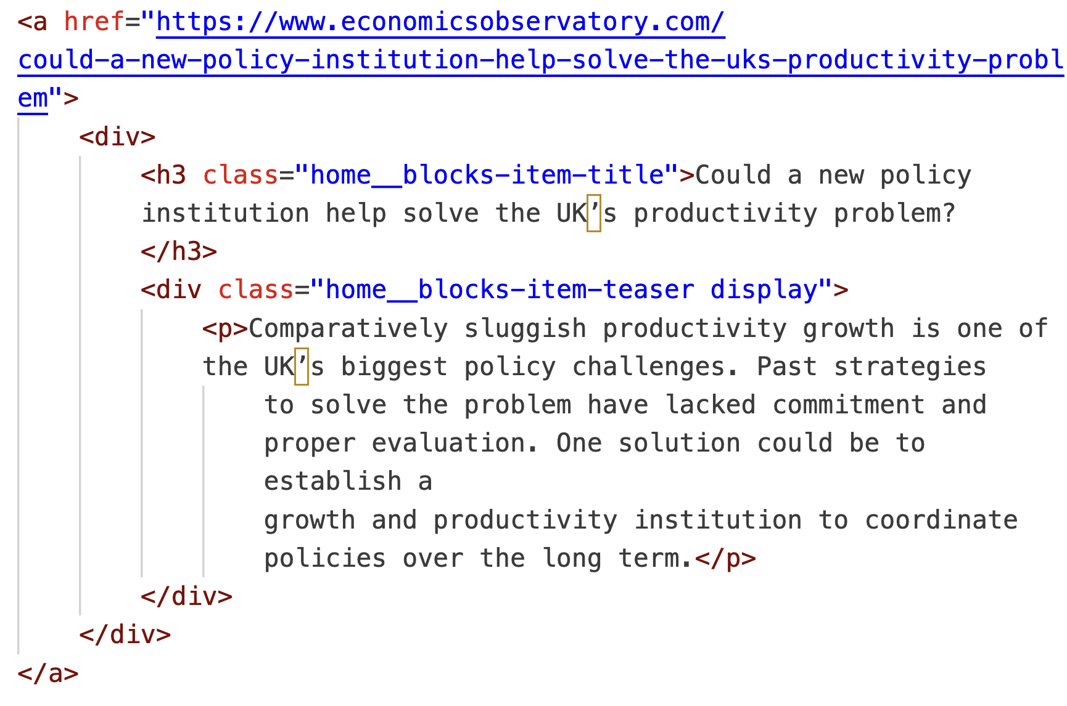
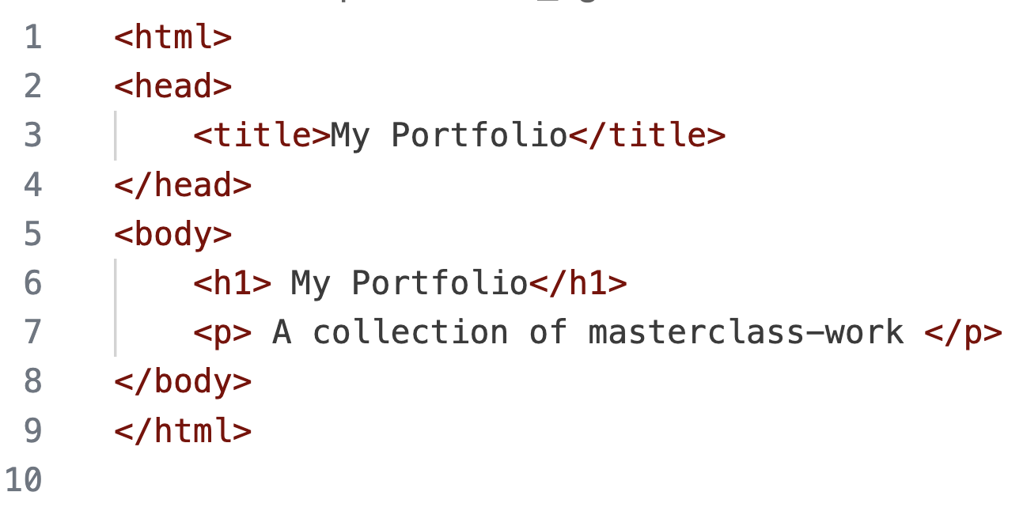
Parsing HTML.
Plan
We started the course by writing HTML
Now we’ll learn to read HTML

Slide 14
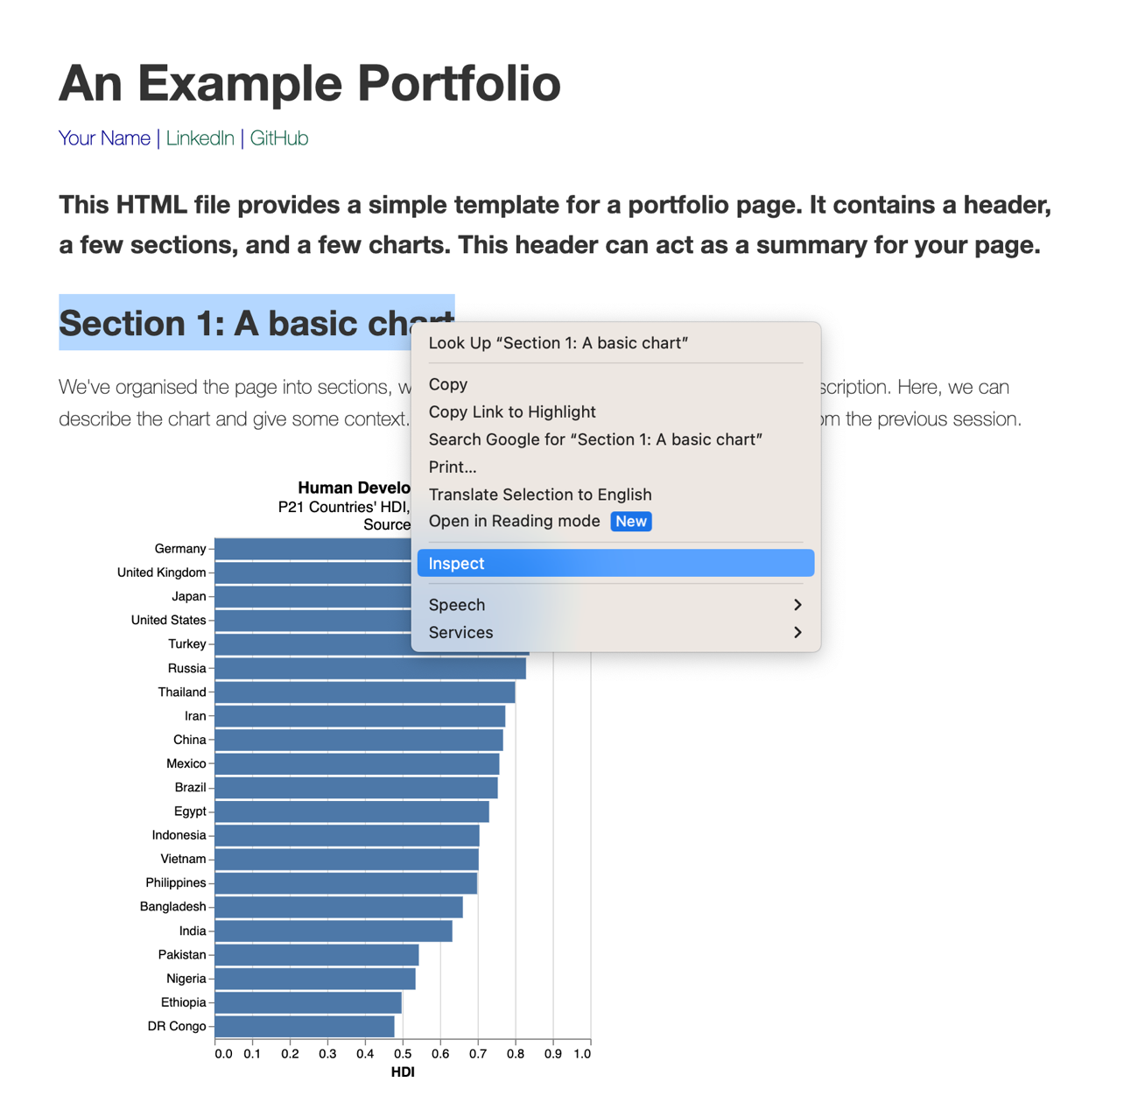
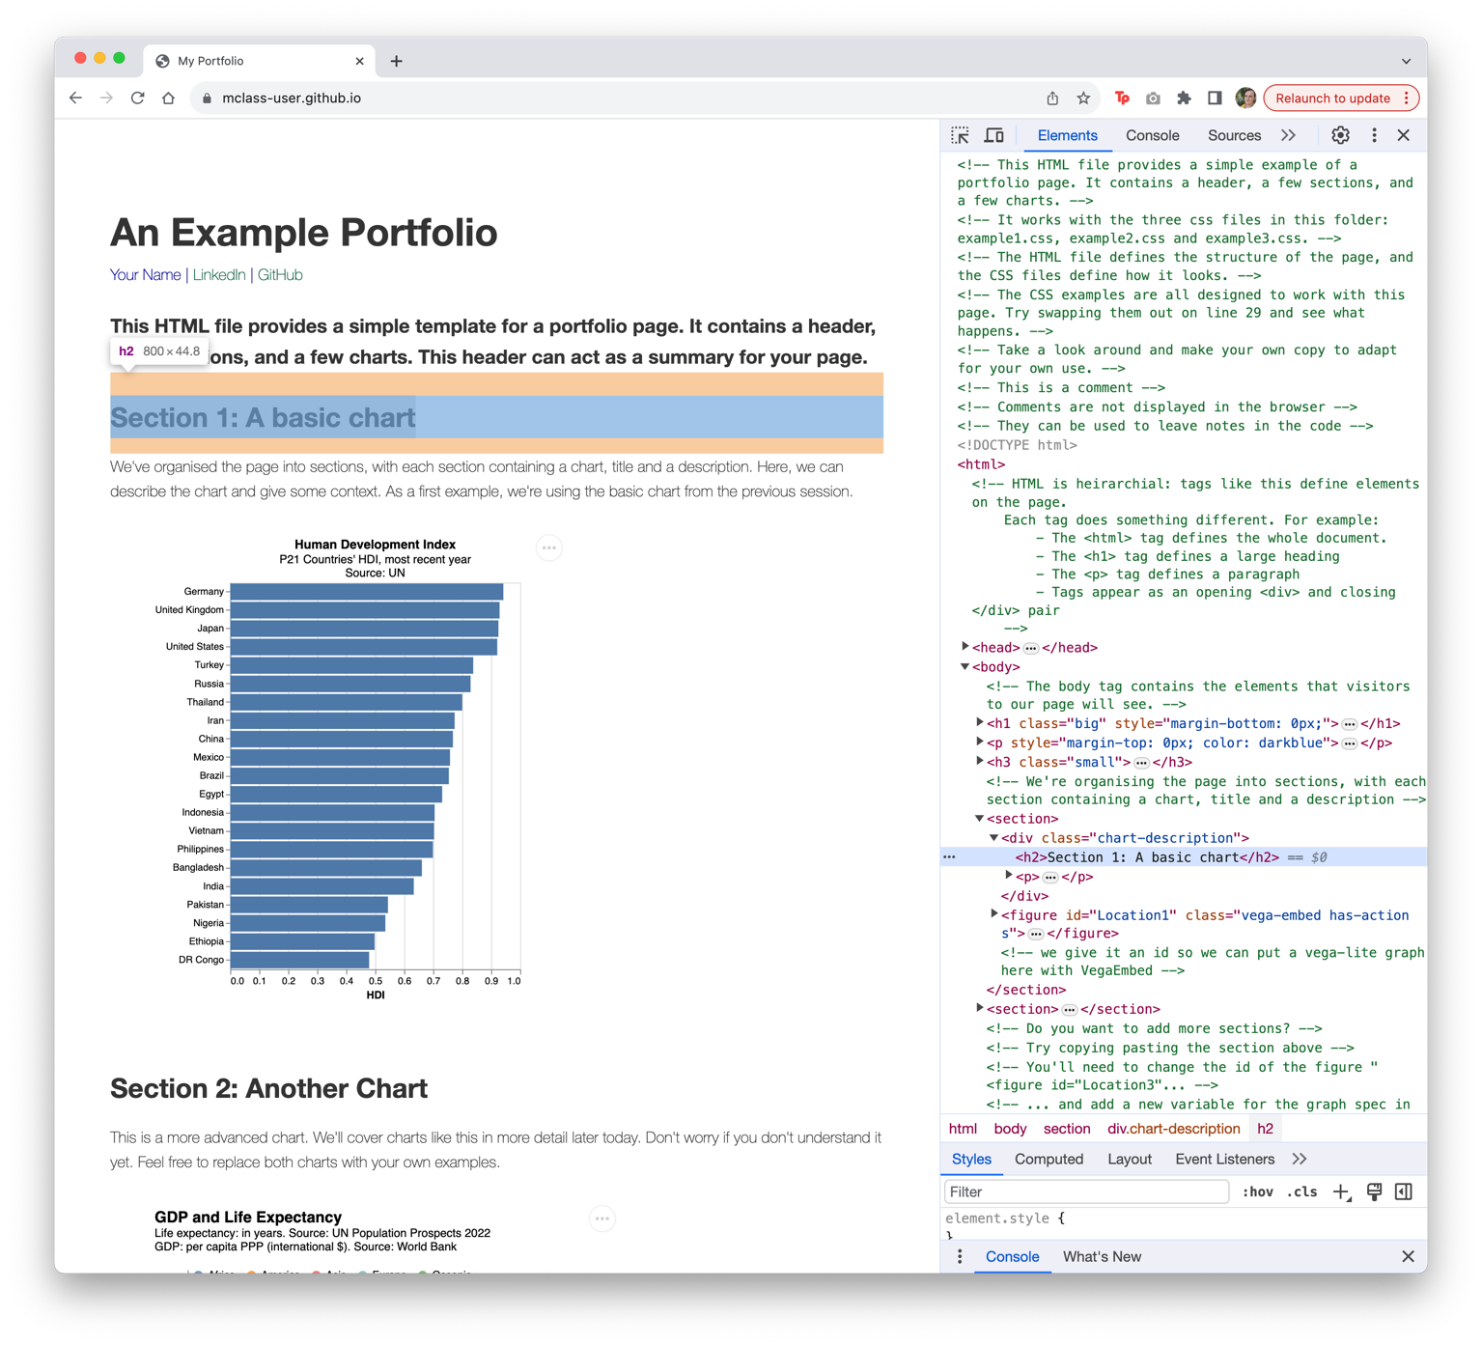
Using inspect-element.
Searching HTML
Our most important tool is ‘inspect-element’
In Chrome, Right-click or Ctrl. Click and select ‘Inspect’

Slide 15
Parsing HTML.
Searching HTML
(Almost) all the data displayed on websites is found in the HTML
We can extract data by searching the HTML
Everything is defined in the HTML, we just have to find it

Slide 16
Overview.
HTML
Determine how data is defined in HTML (inspect element)
Parse the HTML (Beautiful Soup)
Clean the data (Pandas)
Visualise (Vega-Lite)

Slide 17
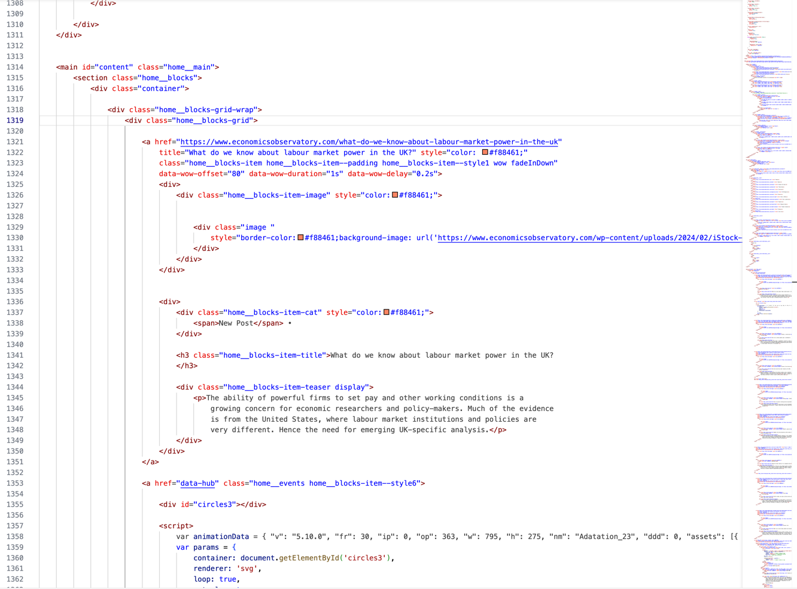
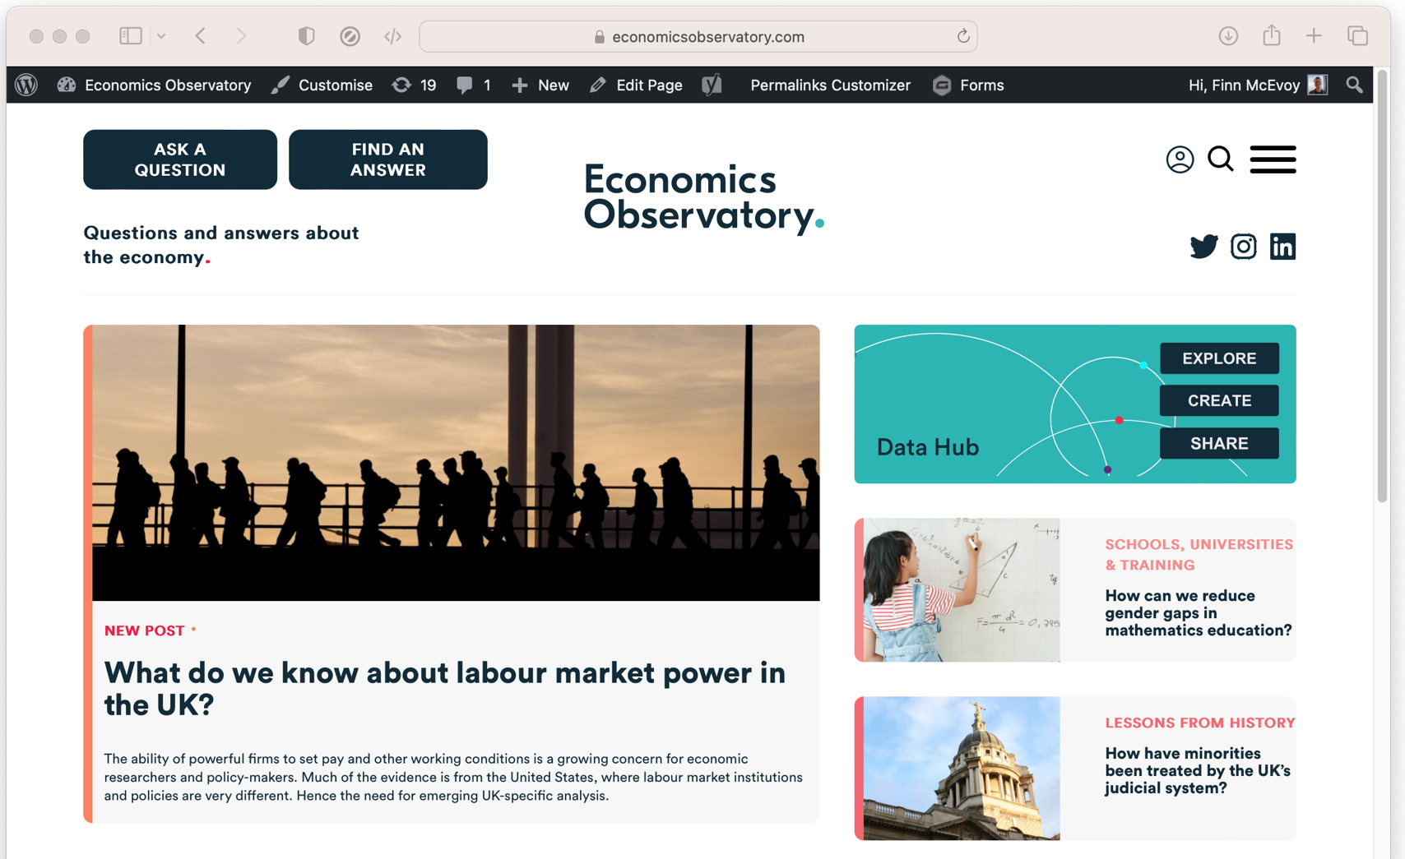
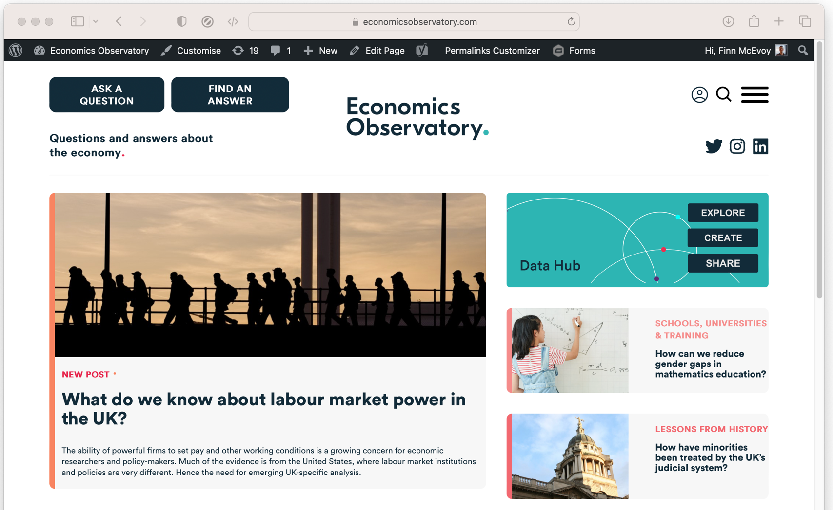
Scraping example.
ECO website
For example, we can scrape ECO headlines and tag-lines by ‘parsing’ the HTML
Notes:
On this page, the HTML (2700 lines long!) defines the page we see

Slide 18
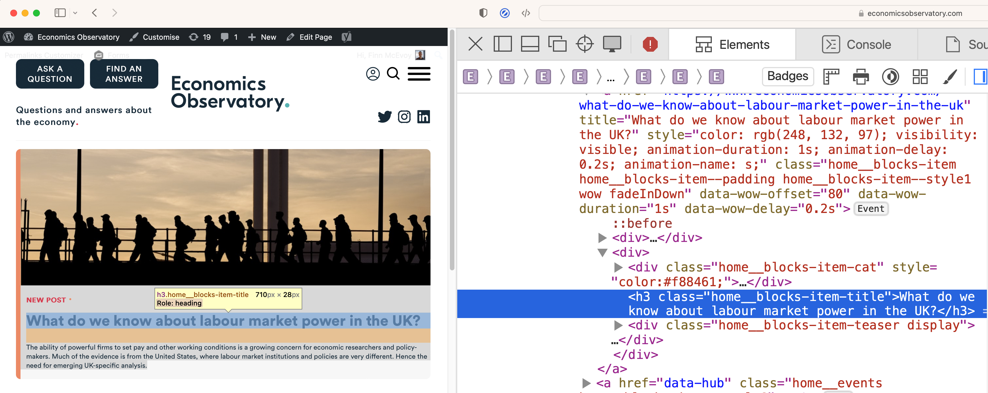
Scraping example.
Using inspect-element
We determine how the target data is defined using ‘inspect-element’
We see titles have a class “home_blocks-item-title”
Notes:
On this page, the HTML (2700 lines long!) defines the page we see

Slide 19
Scraping example.
Parse the HTML
We’ll use use a Python module, BeautifulSoup, to interpret the HTML.
For example, we can look for every title by searching for:
class “home_blocks-item-title”
with
soup.find_all(class_="home__blocks-item-title")
Notes:
On this page, the HTML (2700 lines long!) defines the page we see

Slide 20
Learn more.
In this session we have tried basic data scraping with BeautifulSoup
There’s still much more to learn
Choose your own projects (how can you make your job easier?)
Try bigger projects (scrape 100 pages, not just 1)
Try advanced tools (e.g. Selenium)
Notes:
On this page, the HTML (2700 lines long!) defines the page we see

Slide 21
Practical. Web scraping.
Part 1: Scraping Basics. shorturl.at/wfOXy
Part 2: Scraping ECO. shorturl.at/tWMGY

